Slide 1
Kilmarnock Harrier & AC Parents Evening

Slide 2
Kilmarnock Harrier & AC
Ayrshire Athletics Arena
Club Together
Club Roles
Moving forward
Questions

Slide 3
Ayrshire Athletics Arena

Slide 4
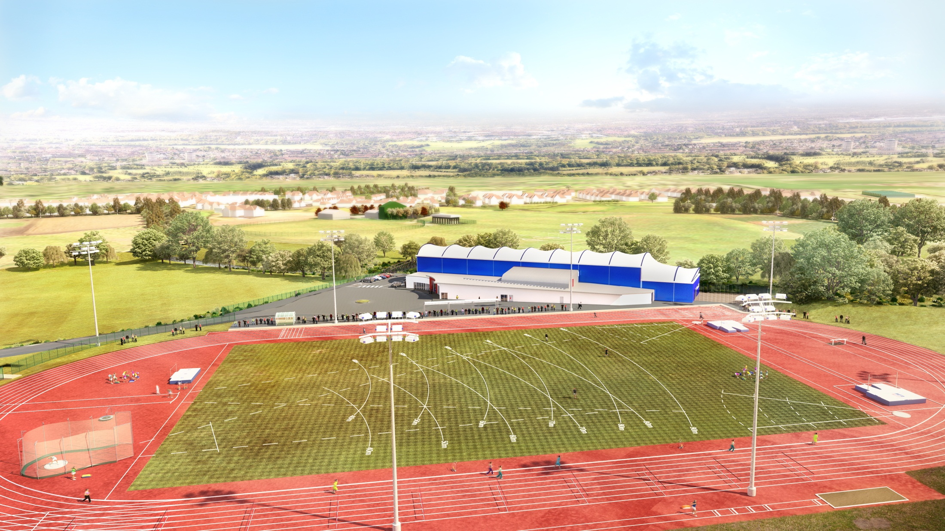

Slide 5
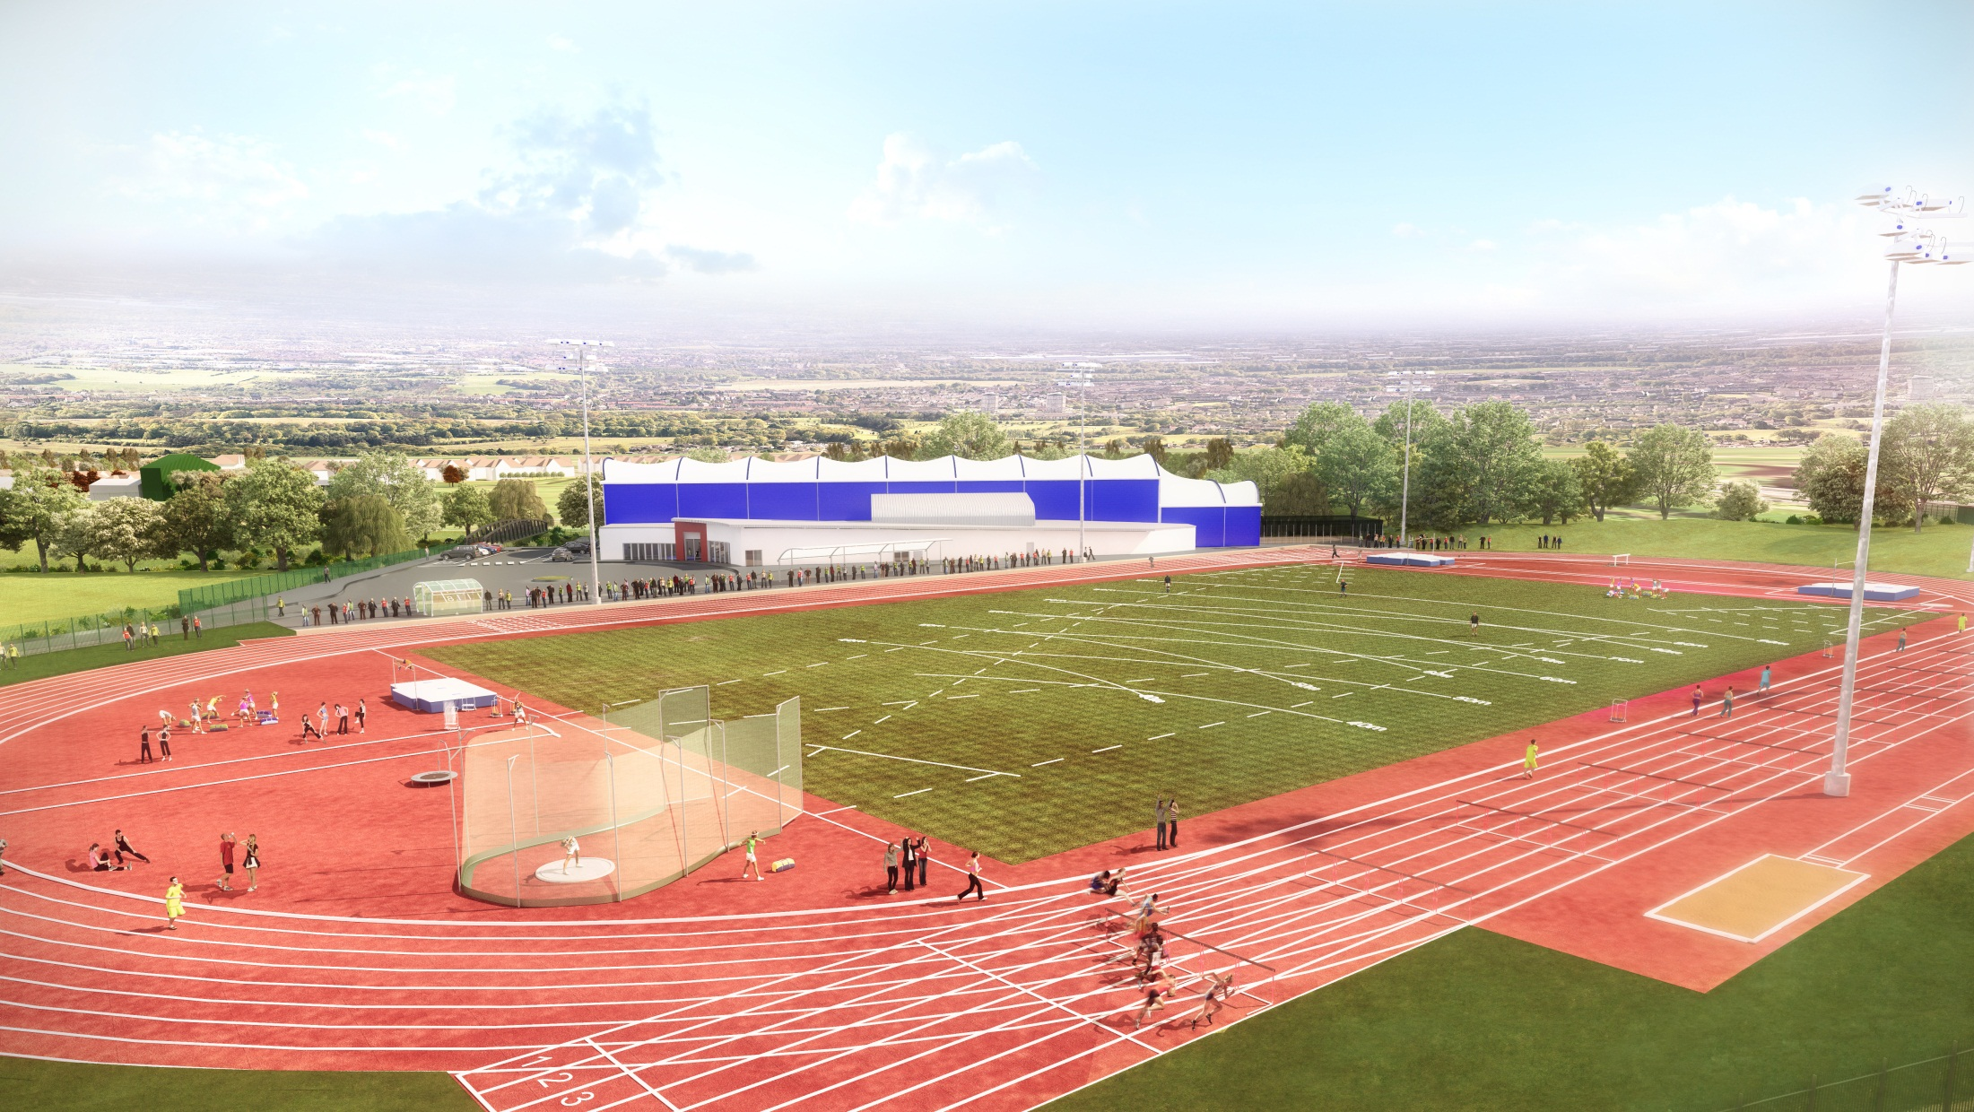

Slide 6
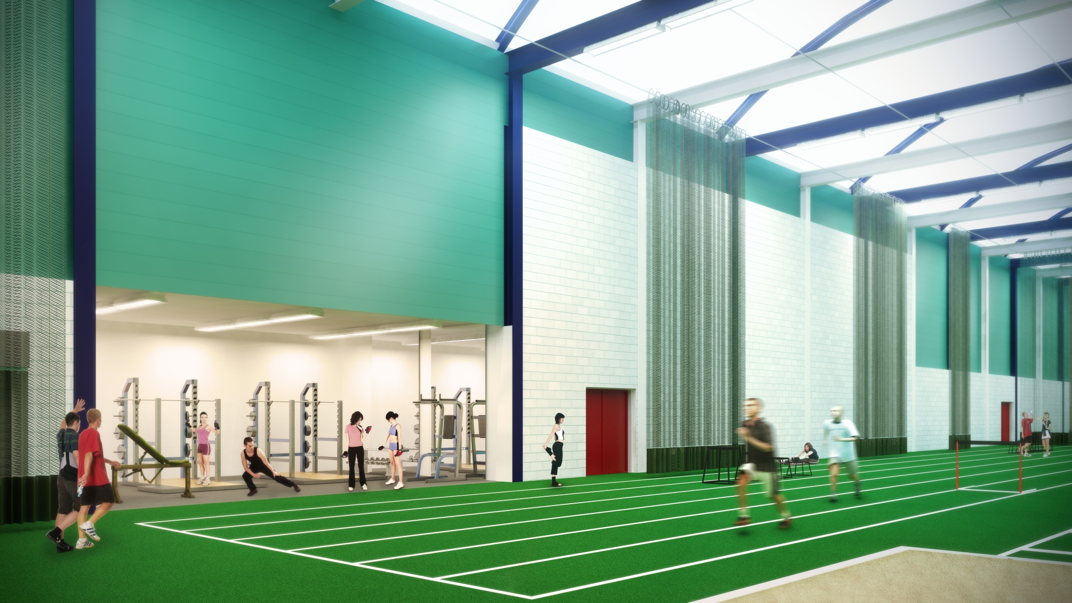

Slide 7
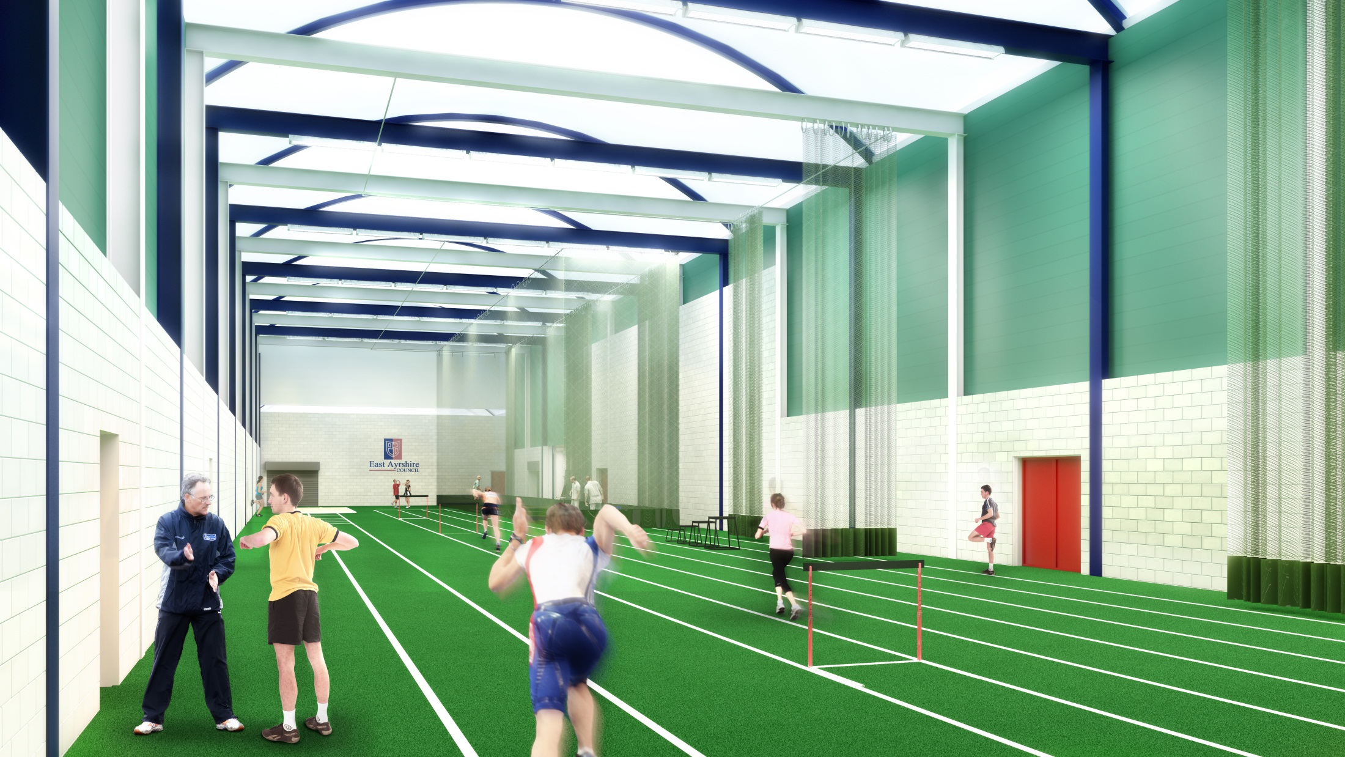

Slide 8
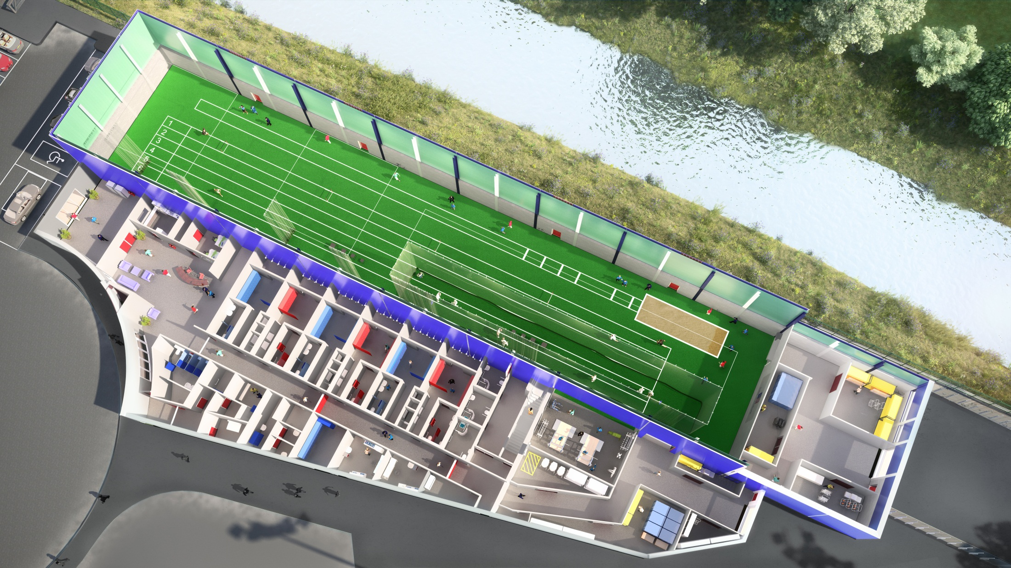

Slide 9
Club Together “The vision for supporting athletics clubs to develop in Scotland”
Performance area
Implementation of club development plan
Increase participation, including competition
Partnership working
Volunteer development
Coaching
Monitoring, evaluating, marketing and communication
Notes:
Explain where we are with each point

Slide 10
Kilmarnock Harriers
Competitions
Club track & field Championships
Club Christmas handicap
Open Graded meeting – 3 held in Ayrshire
Ayrshire championships – track & field, cross-country
West District Championships – track & field, cross-country, cross-country and road relays
Scottish National Championships - track & field, cross-country, cross-country and road relays
Young Athletes League – Selected into team by competing in Ayrshire events

Slide 11
Who and what does it take to organise Kilmarnock Harriers?
Committee – what role do they play?
Coaches – what’s involved?
Officials – what’s involved?
Parents Forum- who leads on this
Volunteer helpers, supervisors- what role do they play
ATHLETES
Notes:
Break out for interactive session – split into groups and get them to highlight what volunteers we need

Slide 12
Kilmarnock Harrier & AC
Membership Co-ordinator*
Clothes and merchandise Co-ordinator
Race Co-ordinator
Press and publicity Officer*
Web site design
Parent helpers – various roles*
Coaches*
First Aider
Health & Safety Co-ordinator
EAC Sports Council Rep
Ayrshire Harriers Rep
President*
Vice President*
Secretary
Minutes Secretary*
Treasurer*
Welfare Officer*
6pm Co-ordinator
7pm Road running co-ordinator*
7pm Health and Fitness Co-ordinator
Club Captain (1 male, 1 female)
Coaching Co-ordinator*

Slide 13
Club Roles
Coaching volunteers:
Head Coach;
Senior Event Coaches;
Event Coaches;
Team Managers;
Head Junior Development;
Induction Coaches;
Coaching Coordinator.
Head Mentor;
Club volunteers:
Chairperson;
Secretary;
Treasurer;
Volunteer Coordinator;
Membership Secretary;
Welfare Officers;
Disability Coordinator;
Junior Coordinator;
Fundraiser;
Health and Safety Coordinator;
First Aid Coordinator;
Social Event Coordinator;
Communications Coordinator;
Club Kit and Merchandise Coordinator;
Refreshment Coordinators and Helpers;
Fixture Coordinators;
Officiating/ Competition
Volunteers:
Officials Coordinators;
Starters /Marksmen;
Track Judges & Field Judges;
Time Keepers;
Photo Finish Officials;
Announcers;
Endurance officials;
Race Directors;
Race/Track and Field referees;
Drink Station Helpers;
Marshalls/Funnel Steward;
Technical Manager;
Risk Assessor;
Clerk of the Course;

Slide 14
Kilmarnock Harriers – Ask yourself the following questions
Do you have administration skills?
Have you worked within a retail environment?
Have you worked with young people?
Do you work in the banking sector?
Do you have min 8 hours per year of free time?
Do your young people enjoy athletics?
Would you like to help more people enjoy the sport?

Slide 15
If YES!!!!!!!!!
We have a role for you!!!

Slide 16
Moving Forward
More volunteers
More athletes
More athletes competing at grass routes – elite
Speak to Mark or Lindsay and complete a volunteer form, it’s that simple!

Slide 17
Kilmarnock Harrier & AC
The way a team plays as a whole determines its success. You may have the greatest bunch of individual stars in the world, but if they don't play together, the club wont be worth a dime.
Babe Ruth

