Slide 1

Club Leaders Workshop

Slide 2

Setting the scene…athletics in Scotland
144 Affiliated Clubs
Circa15,000 club members and 11000 individual members (35% increase in last three years)
25 Club Together Projects
Circa 1,200 qualified coaches operating in clubs
Circa 600 active officials
58 CWG athletes, 33 finalists and 4 medals
30,000 active jogscotland members and
495 jog groups
Challenges
Capacity
Recruit/retention of coaches & volunteers
Participation
Competition from other sports
Coach development
Performance levels

Slide 3
Setting the scene…your club
Your brand/unique selling points?
How would your members describe your club?
Why join?
What does your club stand for?
What does your club do very well?
What are your main challenges?
Events/competitions?
Coaching?
Friendly environment?
Part of the community?
Finding volunteers?
Enough coaches?
Retaining athletes? After 17 years?
KEY AREAS FOR DEVELOPMENT?

Slide 4
Planning – Measuring Success
Key Success Pillars For Clubs
Committee
Structure
Leadership
Right People
The Plan
Volunteers
Recruitment
Retention
Training
Capacity Building
Coaching
Structure
Planning
Recruitment
Coach Development
Standards & Quality
Athletes
Increased Participation
Retention
Community links
Improved performances by age & stage
Governance
Constitution
Welfare
Policy
Legal Status
Charity
Finance
Membership
Structured Fundraising
Gift Aid
Planning
COMMUNICATION

Slide 5
Pillars for Success - Committee
What does your current committee look like now?
Is the Committee providing effective leadership?
What changes are required to make it better?
What are the challenges?
Possible solutions?
Discuss
Visible Structure
Key, clear roles
Planning
Effective Leadership
Right People
Communication

Slide 6

Aberdeen AAC
President
Leadership & management
Vice President
Outreach, Development, ASV &
member liason
Secretary
Administration,
Media & Digital
Communications
Finance
Officer
Income,
expenditure
grants and
sponsorship
Coaching
Coordinator
Athlete
development
& improvement via
an effective
coaching system
Competition
Coordinator
Facilitating an
effective
competition
structure
for the Club
Officials
Coordinator
Leading a
cadre of
officials meeting Club and national
requirements
5 Ordinary Committee Members
Coaches
Team
Managers
Officials
Membership Officer
Membership database
management & affiliations
Club Together Officer
Directed by the Committee in line with the Club Development Plan
Welfare Officer
Providing independent
advice and adjudication
to the Club & members

Slide 7

Club Structure Example - Garscube Harriers
Club Chairperson
Vice-Chair
Secretary
Treasurer
Welfare Officer
Website Officer
Social Convenor
Coach Coordinator
Club Parents
Club Athletes
Club Coaches
(see Coaching Structure)

Slide 8
The Plan
Have you got a plan?
Is it effective – clear, concise and delivered
Is it visible?
Do you use it as a committee? If so, how?
Do you share it?
What are your key priorities?
Need help?
SAL online Club Development Toolkit

Slide 9
Key Priorities for your Club
Key Success Pillars For Clubs
Committee
Structure
Leadership
Right People
The Plan
Volunteers
Recruitment
Retention
Training
Capacity Building
Coaching
Structure
Planning
Recruitment
Coach Development
Standards & Quality
Athletes
Increased Participation
Retention
Community links
Improved performances by age & stage
Governance
Constitution
Welfare
Policy
Legal Status
Charity
Finance
Membership
Structured Fundraising
Gift Aid
Planning
COMMUNICATION

Slide 10
Pillars for Success - Volunteers
Do you as a club have a sufficient number of volunteers?
Where are your gaps?
Discuss
Recruitment
Retention
Training
Rewarding
Capacity Building

Slide 11
Volunteer Recruitment
What skills do your current members have?
Within your club?
Parents Induction
Questionnaire
Targeted approach
Social events
How do you currently recruit?
Externally?
Volunteer centre
Retired/semi-retired
University/Colleges
External Advertising
Need help?
SAL online Club Development Toolkit

Slide 12
Volunteers - Retain and Reward
How do you help train and support volunteers?
Reward – Do you reward volunteers?
Potential ideas
Mentoring
Training
Thank You
Kit
Social Events
Reduction on Fees
Award Ceremonies

Slide 13
Planning – Measuring Success
Key Success Pillars For Clubs
Committee
Structure
Leadership
Right People
The Plan
Volunteers
Recruitment
Retention
Training
Capacity Building
Coaching
Structure
Planning
Recruitment
Coach Development
Standards & Quality
Athletes
Increased Participation
Retention
Community links
Improved performances by age & stage
Governance
Constitution
Welfare
Policy
Legal Status
Charity
Finance
Membership
Structured Fundraising
Gift Aid
Planning
COMMUNICATION

Slide 14
Pillars for Success - Coaching
Coaching structure
What does your coaching structure look like?
Does your club have:
A Coach Co-ordinator
A Lead Coach for each stage
A Coach Mentor
An Age and Stage Pathway
Coach Meetings
Regular updates to members

Slide 15
Coaching Structures?
Club Committee
Coach Coordinator
Coach Mentor / Head Coach
Head Children’ Coach
Event Groups
Event Specialist Coaches & Assistant Coaches
Childrens’ Section
Endurance Lead & Coaches
Jumps Lead & Coaches
Note: Clubs could/should consider working together where gaps exist and they can’t fill them in short term
Throws Lead & Coaches
**CTO – role???
S & H Lead & Coaches

Slide 16
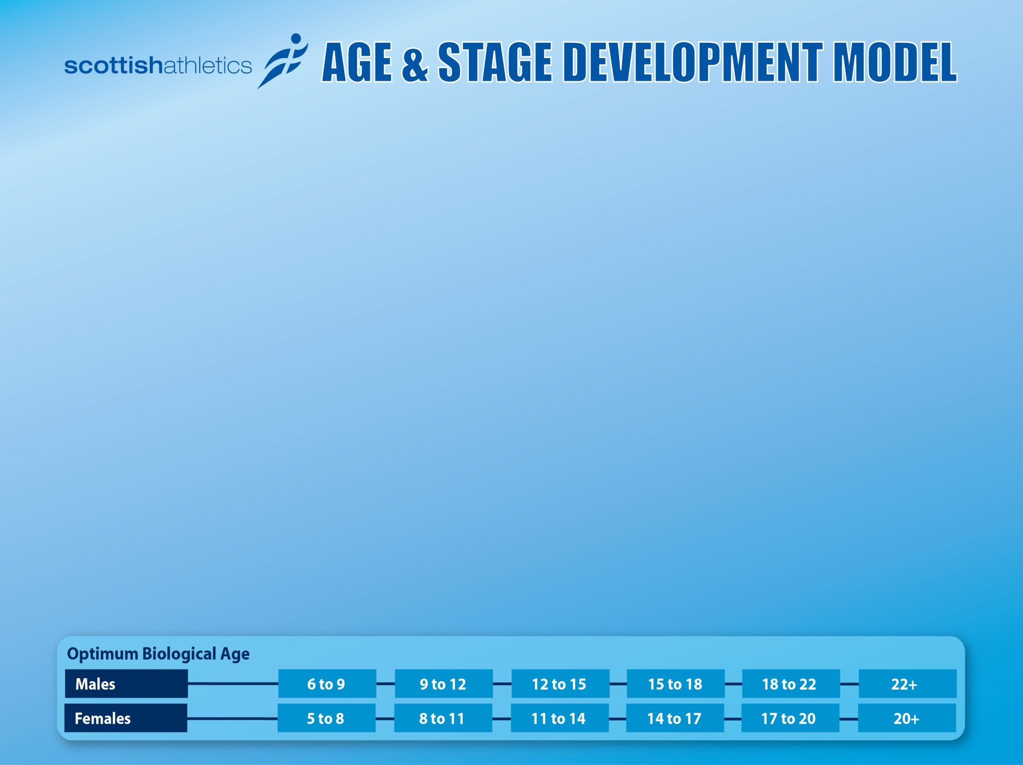
Notes:
Tutor Notes:
New Proposed LTAD Model
Focus on the key stages and that club’s coaching structures should reflect this.
Note – This is the Adapted IAAF Model.

Slide 17
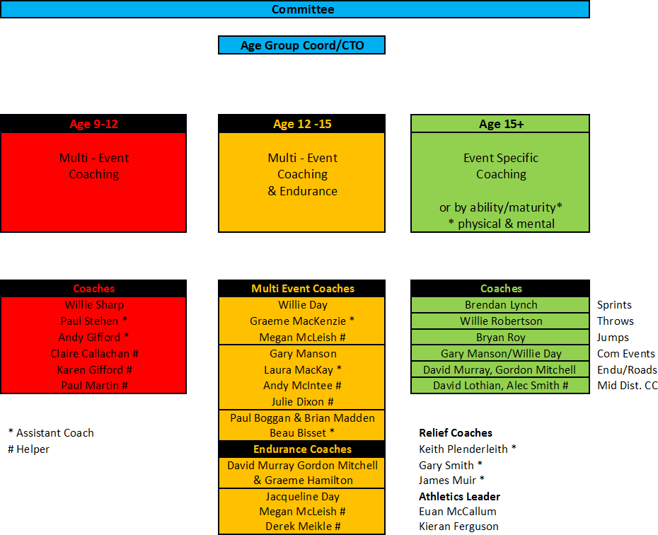
Example Coaching Structure - Falkirk Victoria Harriers

Slide 18
Example Coaching Structure - Pitreavie AAC
Participation
Club - Pitreavie AAC
Endurance Group
Throws Group
School Events
Reception Group
(Ages 9-13)
Intermediate Group
(Ages 14-15)
High Jump/Multi-Events
Group
Pole Vault Group
Run Jump Throw
Hurdles / Sprints Group
After School Clubs
Sprints Groups x 2
Jumps
(supplement coaching)
Independent Coaches

Slide 19

Example Club Coaching Structures & Planning
18+ Years
(Specialisation)
NO AGE GROUPS
Event Specific Lead Coaches
4 Groups
8 Coaches
15+
Event-Specific Coaching
Group 1
16-18 Years
(Specialisation)
Group 1
Group 1+2
Group 3+4
8 Coaches
14-15 Years (Event Group)
Group 1
Group 2
Group 3
Group 1
Group 2
6 Coaches
Lead 12-15 Event Group Coaches
Multi-Event Coaching
12-13 Years (Event Group)
Group 1
Group 2
Group 3
Group 4
8 Coaches
Group 1
Group 2
9-12 Years (Multi Events)
Group 1
Group 2
Group 3
Group 4
Group 5
10 Coaches
Lead Children’s Coach
Group 1
Group 2
Group 3
5 – 8 Years (RJT)
Group 1
Group 2
Group 3
Group 4
Group 5
Group 6
12 Coaches
Lead RJT Coach
Recommended Coach:Athlete Ratio = 1:12 (pref. 2:12)
Notes:
Tutor Notes:
MAKE REFERENCE TO ACTUAL STATS ON NUMBER COACHES /ATHLETES ETC
Following up on last couple of slides this diagram is designed to get clubs thinking around coach recruitment and development/focus.
It is based on the LTAD stages to age 18+ with multi-event and events group conditioning and skill development through to age 15 before specialisation may enter the equation.
Each club’s diagram will vary depending on size of club and it’s vision – make sure you communicate this – example imposed of smaller club
Key areas to communicate:
Number of coaches that will be required to comfortably cater for and DEVELOP athletes recruited through club vision/plans
We are promoting a lead stage coach – right hand column
Ideal ratios would be 2 coaches to group of 12 athletes (effective time with athletes plus cover if coaches unavailable etc)

Slide 20
Coaches
Recruit
Where are you going to recruit new coaches?
What skills do your current members have?
Where are the gaps, if any?
Are coaches progressing?
Do you have a coaching plan?
Retain
Are you offering training?
Continuous support?
Reward
Consider:
Funding for Coach Education and Development
scottishathletics Coach Mentor Visit
CPD – Local and National
Child Protection and First Aid
Inclusion
Succession planning

Slide 21
scottishathletics Coaching Update
National Coaching Syllabus
Movement Dynamics & UKA Athletics 365 Resources
Club Visit Programme – National Event Mentors
National Coach Mentor Programme
Leading Athletics Certificate Course (14+ / 3 Hours)
Coaching Assistant (Entry age lowered to 16 yrs in Scotland)
Level 3 Online Modules – majority modules complete
National Coaching Weekends/Days – Sept/Oct/Dec/March
Coaching Zone

Slide 22
Coaching Qualifications/ Certification
UKA Event Specialist Online Modules (L4)
Need More Info? – Click here
UKA Event Group Online Modules (L3)
Physical Preparation Module
UKA Athletics Coach (L2)
UKA Coach in Running Fitness (L2)
UKA Coaching Assistant (L1)
*Leading Athletics
*Jogleader
(Leader in Running Fitness)
*Entry Level Certificate

Slide 23
Paid Coaching Structure
A number of clubs are now paying coaches and examples include:
Paying RJT club sessions outside normal nights
Paying coaches to deliver school based sessions
Paying for a gap in coaching pathway (eg throws coach)
Paying for additional training nights where volunteers
could not be sourced initially
Integrated paid and volunteer coaching model (eg Team East Lothian)
Individual coaches charging athletes fees
Paying for ad-hoc coach mentoring
Consider:
Employed/Self Employed
Contracts/Agreements
HMRC Compliant
Need help?
SAL online Club Development Toolkit

Slide 24
Planning – Measuring Success
Key Success Pillars For Clubs
Committee
Structure
Leadership
Right People
The Plan
Volunteers
Recruitment
Retention
Training
Capacity Building
Coaching
Structure
Planning
Recruitment
Coach Development
Standards & Quality
Athletes
Increased Participation
Retention
Community links
Improved performances by age & stage
Governance
Constitution
Welfare
Policy
Legal Status
Charity
Finance
Membership
Structured Fundraising
Gift Aid
Planning
COMMUNICATION

Slide 25
Pillars for Success – Athletes
Athlete Recruitment and Community Links
How do you recruit athletes?
Juniors
Seniors
Are your Run, Jump, Throw centres / community groups linked to your club structure?
Have you got a specific role for a school - club link
co-ordinator?
Are you an inclusive club?
Consider:
Links with your cluster school
Club visit taster session
Lettered invitations to come and try sessions
Attending/Helping at local school events
Word of mouth
Adults – Jogscotland (Dundee Hawkhill Harriers example), Local events, FE/HE
Need help?
SAL online Club Development Toolkit

Slide 26
Example of RJT Centres integrated to Club
Livingston and District AAC Club
Mainly Craigswood S.C
Monday, Tuesday, Wednesday, Thursday, Sunday - 9 years +
Livingston and District AAC RJT Centre
Inveralmond CHS
Monday – aged 7 - 11
Livingston and District AAC RJT Centre
Craigswood SC
Monday – aged 7 – 8
Livingston and District AAC RJT Centre
Craigswood SC
Saturday – aged 7 -11
Livingston and District AAC RJT Centre
Deans CHS
Monday - aged 7 - 11

Slide 27


Example of Satellite Centres integrated to Club
Aberdeen AAC
Aberdeen Sports Village
Monday 1730-2030, Tuesday 1700-1900, Wednesday 1730-2030, Thursday 1800-1930, Saturday 0930-1200, Sunday 0930-1200
TGS, Huntly
Monday
Kids@ASV
Tue/Wed/Fri
RGU, Aberdeen
Tuesday
Westhill
Tuesday
Inverurie
Friday

Slide 28
Athlete Retention
How do you retain your athletes?
Do you have the appropriate coaching structure to support your desired athlete pathway?
Do you have the appropriate competition
structure to support your desired athlete
pathway?
Are you athlete centred?
Consider:
Sociable environment
Appropriate Competition
Parent Education
Quality Coaching
Athlete Reps
Volunteering opportunities
Athlete Tracking
Open to all/inclusive

Slide 29
Notes:
Tutor Notes:
New Proposed LTAD Model
Focus on the key stages and that club’s coaching structures should reflect this.
Note – This is the Adapted IAAF Model.

Slide 30
Planning – Measuring Success
Key Success Pillars For Clubs
Committee
Structure
Leadership
Right People
The Plan
Volunteers
Recruitment
Retention
Training
Capacity Building
Coaching
Structure
Planning
Recruitment
Coach Development
Standards & Quality
Athletes
Increased Participation
Retention
Community links
Improved performances by age & stage
Governance
Constitution
Welfare
Policy
Legal Status
Charity
Finance
Membership
Structured Fundraising
Gift Aid
Planning
COMMUNICATION

Slide 31
Pillars for Success - Governance
What does good governance mean?
Having an up to date constitution
Considering scottishathletics club accreditation – Foundation and Podium Award
Focussing on the organisations purpose and on outcomes for club
Performing effectively in clearly defined functions and roles
Developing the capacity and capability of the organisation
Taking informed, transparent decisions and managing risk
Promoting values for the whole organisation and demonstrating the values through behaviour
Engaging stakeholders and making accountability real
Need help?
SAL online Club Development Toolkit

Slide 32
Governance - Welfare & Club Policy
Does your club have the following:
Welfare Officer(s)
Welfare Policy/Child Protection
Equity Policy
Health & Safety procedures – risk assessment/first aid
Codes of Conduct
Consider:
Does your club have a process to deal with grievances or complaints?
Need help?
SAL online Club Development Toolkit

Slide 33
Inclusive Club
Consider:
Open - without concession, modification or change.
Modified - with appropriate adaptions to rules, equipment or setting to facilitate the inclusion
Parallel - grouped according to ability or equipment being used.
Discrete - unique, development, meaningful and meets the needs of all

Slide 34
Legal structure & charitable status
What are our options?
Unincorporated Association
Charitable Status
Scottish Charitable Incorporated Organisation (SCIO)
Community Amateur Sports Club (CASC)
Company Limited by Guarantee
Charitable Status and Company Limited by Guarantee

Slide 35
Legal Structure
Unincorporated Association
Most common among sports clubs
Requires a constitution
Presents a number of risks including:
    Management committee are liable for any losses with no limit to liability
    Not allowed to trade
Charitable Status
Still no limit of liability and not allowed to trade
Offers rate relief
Potential to increase confidence of stakeholders in governance and financial management

Slide 36
Legal Structure
SCIO
Newish legal form for charities
A corporate body with ability to enter into contracts, employ staff, incur debts, own property, to sue and to be sued
High degree of protection against personal liability
Regulated by OSCR and require one set of accounts, one set of annual returns
All assets become assets of SCIO
CASC
Registered with the Inland Revenue
80% relief from uniform business rates
Exemption from Corporation Tax on certain areas and access to Gift Aid
Membership must be open and membership levels set at reasonable level
No provision to de-register

Slide 37
Legal Structure
Company Limited by Guarantee
Separate legal identity to its members
Requires Articles of Association and Directors
Club can enter into contracts
Limited Liability
Require to file accounts and an annual return to Companies House
Requires robust governance and financial management
Charity and Company Limited by Guarantee
Offers everything a club requires in terms of legal personality, rates relief, access to Gift Aid, limit of liability, access to funding opportunities
Flexibility to change at a later date
Two sets of paperwork to file as dual accountability

Slide 38
Contact Details for further support
Contact your scottishathletics Regional Development Manager (click here)
Voluntary Action Scotland, Third Sector Interface: www.vascotland.org/tsis/find-your-tsi
Alan Fowler - Alan@fifevoluntaryaction.org.uk
Penny Lochhead - penny@pmrleisure.co.uk Website: www.pmrleisure.co.uk

Slide 39
Planning – Measuring Success
Key Success Pillars For Clubs
Committee
Structure
Leadership
Right People
The Plan
Volunteers
Recruitment
Retention
Training
Capacity Building
Coaching
Structure
Planning
Recruitment
Coach Development
Standards & Quality
Athletes
Increased Participation
Retention
Community links
Improved performances by age & stage
Governance
Constitution
Welfare
Policy
Legal Status
Charity
Finance
Membership
Structured Fundraising
Gift Aid
Planning
COMMUNICATION

Slide 40
Pillars for Success - Finance
Core Funding
Membership Fees
Structured Fundraising
Gift Aid
Grant Applications
Need help?
SAL online Club Development Toolkit

Slide 41
3 Key Priorities & Actions for your club
1.
2.
3.
Next Steps….

Slide 42

scottishathletics Regional Managers contacts (click here) www.scottishathletics.org.uk www.sportscotland.org.uk/clubs/help_for_clubs
More resources & useful contacts

